Slide 1
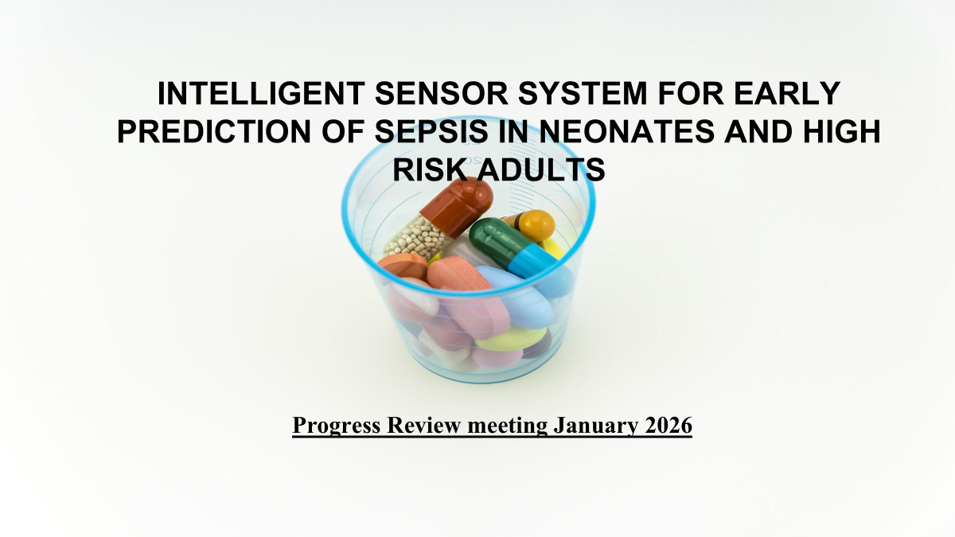

Slide 2
Confirmation of Biomarker panel
Universal Bacterial Detection :N-acetylmuramic acid (NAM)
Gram-Positive–Specific Marker : Lipoteichoic Acid (LTA)
Gram Negative specific marker :Lipopolysaccharides (LPS)
The following panel is selected on the basis biomarker exclusivity to bacteria, surface accessibility for SERS detection, and Gram classification capability

Slide 3
Computational Approach Overview :
The team conducted simulations using few basic molecules to learn about the software settings and configuration.
Gained proficiency to apply it to our selected biomarker panel and help in the project goals.
Interpretation and analysis of raman spectrum using KnowItAll® Raman Identification Pro software suite will be carried out

Slide 4
Pure Biomarker standards
Procurement procedures following institute administrative process is completed and first consignment of biomarkers are received .
With procurement milestones and technical preparation, the research team is looking forward to transition from planning and preparation to active experimental work with confidence and efficiency.

Slide 5
Comparison table for Which Solvent Has the Highest Overall Solubility?
Biomarker / Solvent | Water | PBS (pH 7.2–7.4) | DMSO | DMF | Ethanol
LTA (Staph. aureus) | 5 mg/mL (hazy) (MilliporeSigma) | Moderate (hazy; comparable to water), qualitative (MilliporeSigma) | Unknown | Unknown | Moderate (MilliporeSigma)
MurNAc | ~50 mg/mL (clear) (ChemicalBook) | ~10 mg/mL (Cayman Chemical) | ~30 mg/mL (Cayman Chemical) | ~2.5 mg/mL (Cayman Chemical) | Unknown
LPS (E. coli O111:B4) | ~5 mg/mL (hazy; up to ~20 mg/mL with heat) (MilliporeSigma) | Moderate (hazy solutions in PBS; similar to water) (MilliporeSigma) | Poor / Not reported (organic solvents do not yield clearer solutions) (MilliporeSigma) | Unknown | Poor (methanol/ethanol produce turbid suspensions with precipitates) (MilliporeSigma)

Slide 6
Best Solvent for Each Biomarker
Biomarker | Best Solvent /Highest Solubility
LTA | Water (5 mg/mL)
MurNAc | Water (~50 mg/mL)
LPS | Water (~5 mg/mL)
Why Water is the first choice:
Water has very weak Raman background
No phosphate → no overlap with biomarker peaks

Slide 7
Minimum Limit of Detection (LOD)
Dilution | Concentration (mg/mL)
Stock | 1.0
10⁻¹ | 0.1
10⁻² | 0.01
10⁻³ | 0.001
10⁻⁴ | 0.0001
Goal: Collect reliable spectra.
For each biomarker:
Measure spectra at each concentration
Maintain same acquisition settings
Collect:
Multiple spectra per condition
Check:
Whether expected characteristic peaks appear
Whether peak positions remain stable across concentrations
Compare:
Across concentrations
Across sensors

Slide 8
Thank You

Slide 10
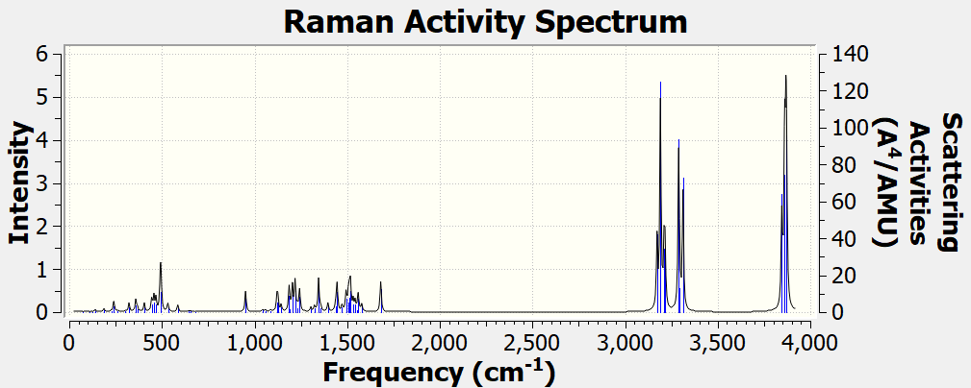

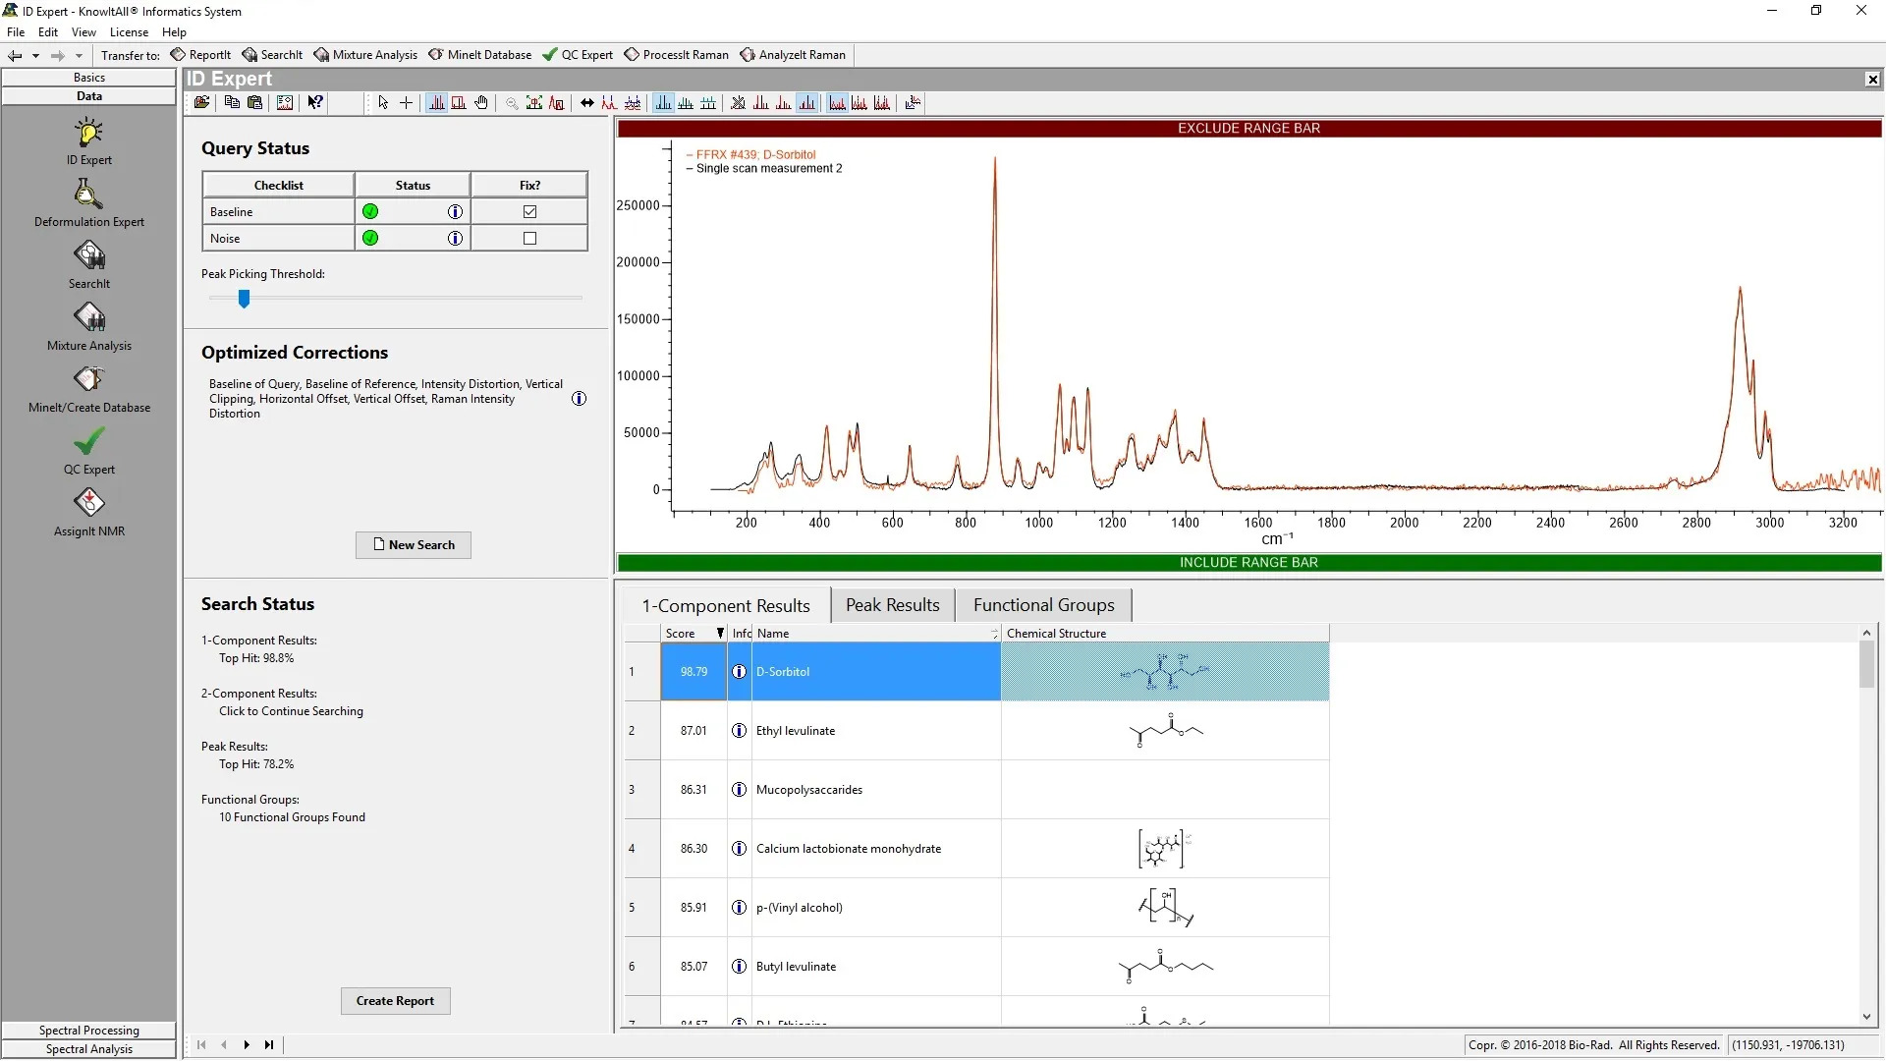
Load Glucose Raman Spectrum into KnowItAll®
Import a reference glucose Raman spectrum (library / demo / public database)
This spectrum acts as a training and validation sample, not a biomarker
Purpose: To demonstrate correct peak interpretation and software usage before biomarker analysis.
Glucose
Functional Group Assignment
Peaks correspond to specific chemical bonds, not random signals.
KnowItAll® compares:
Peak positions
Relative intensities
Functional group patterns

